Slide 1
Discrete Mathematics
Xiaowei Yang
South China University of Technology

Slide 2
Chapter 6. Graphs
Representing Graphs and Graph Isomorphism
Section 6.3

Slide 3
Contents
1
Adjacency and Incidence Matrices
2
Isomorphism of Graphs

Slide 4
Representing Graphs

Slide 5
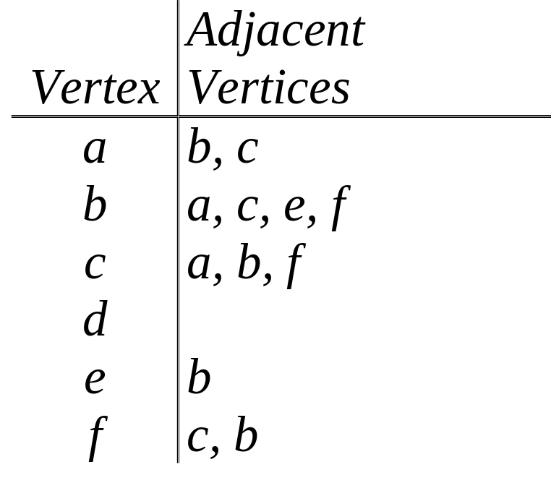
Adjacency Lists of Simple Graphs
A table with 1 row per vertex, listing its adjacent vertices.
a
b
c
d
e
f

Slide 6
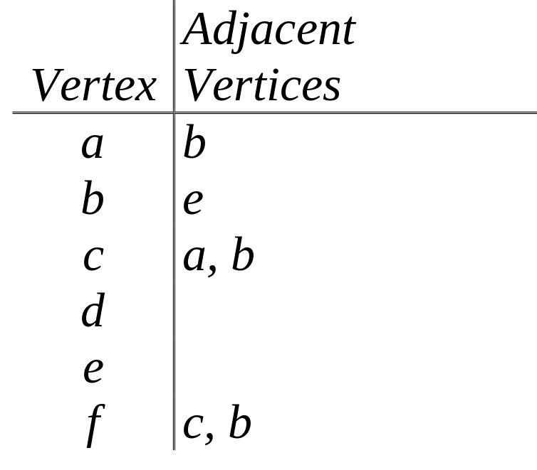
Adjacency Lists of Directed Graphs
A table with 1 row per vertex, listing its adjacent vertices.
a
b
c
d
e
f

Slide 7
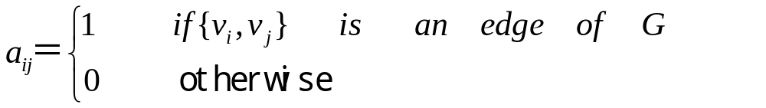
Adjacency Matrix
Suppose that G＝<V, E> is a simple graph where |V|＝n.
Suppose that the vertices of G are listed arbitrarily as V＝{v1，v2，…，vn}.
The adjacency matrix A (or AG) of G is the n x n zero-one matrix with 1 as its (i,j)th entry when vi and vj are adjacency matrix is A=[aij].

Slide 8
Some properties of adjacency matrix
The adjacency matrix of a simple graph is symmetric, that is, aij=aji, since both of these entries are 1 then vi and vj are adjacent, and both are 0 otherwise.
Furthermore, since a simple graph has no loops, each entry aii, i=1,2,3,…,n is 0.
There are relatively few edges in a graph, the adjacency matrix is a sparse matrix, that is, a matrix with few nonzero entries.

Slide 9
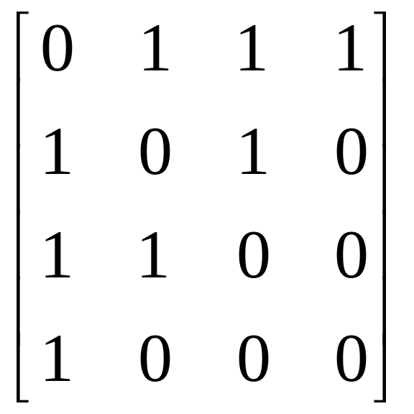
Example 3
Use an adjacency matrix to represent the graph.
a
b
c
d

Slide 10
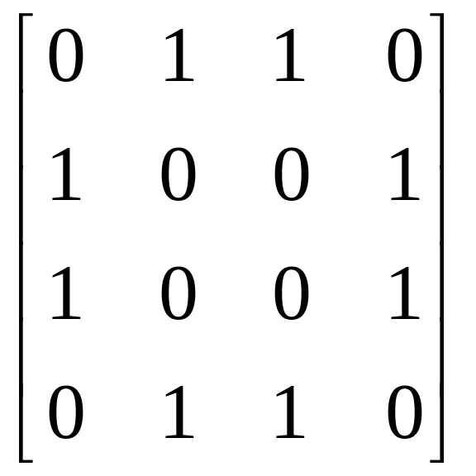
Example 4
Draw a graph with the adjacency matrix
a
b
c
d

Slide 11
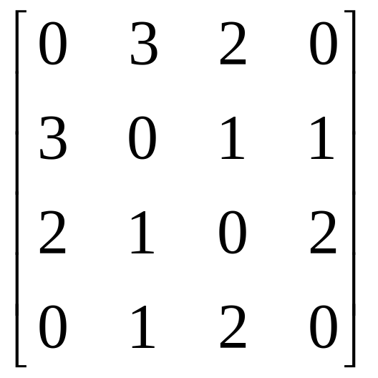
Example 5
When multiple edges are present, the adjacency matrix is no longer a zero-one matrix, since the (i, j)th entry of this matrix equals the number of edges that are associated to { ai, aj }.
a
b
c
d

Slide 12
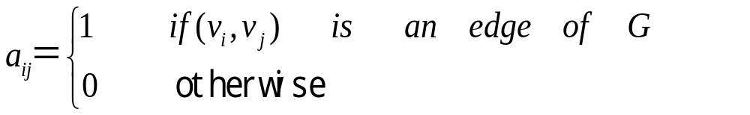
The matrix for a directed graph G＝<V, E> has a 1 in its (i, j)th position if there is an edge from vi to vj, where v1, v2,…,vn is an arbitrary listing of the vertices of the directed graph.

Slide 13
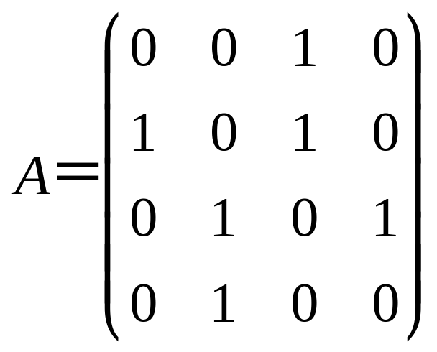
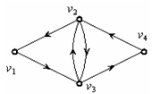

Slide 14
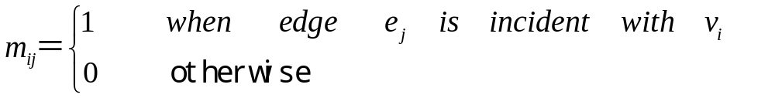
Incidence Matrices
Let G＝<V, E> be an undirected graph. Suppose that v1,v2,…,vn are vertices and e1,e2,…,em are the edges of G.
Then the incidence matrix with respect to this ordering of V and E is the n x m matrix M = [ mij ], where

Slide 15
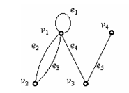
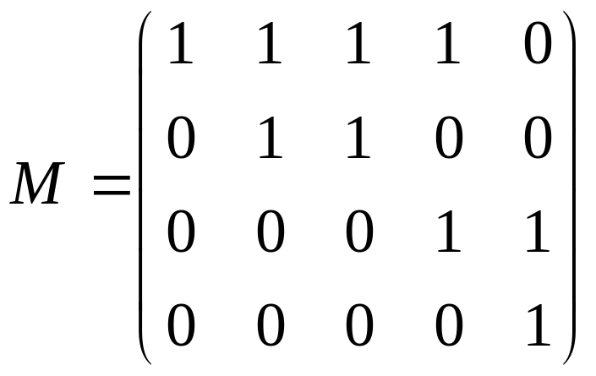

Slide 16
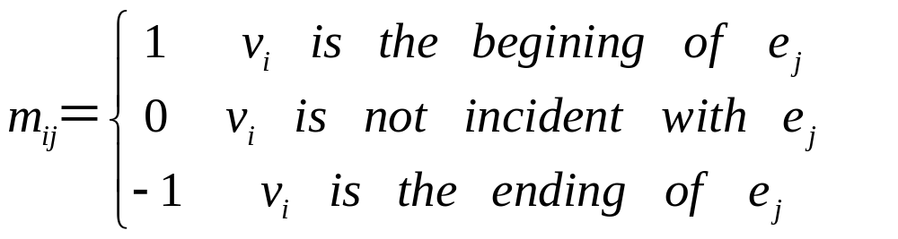
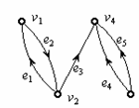
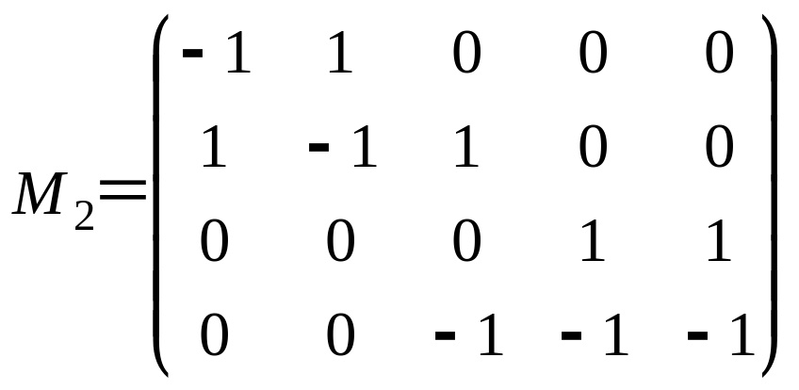
Directed Graphs

Slide 17
Isomorphism of Graphs

Slide 18
What is isomorphic?
The simple graphs G1=(V1,E1) and G2=(V2,E2) are isomorphic if there is a one-to-one and onto function f from V1 to V2
with the property that a and b are adjacent in G1 if and only if f(a) and f(b) are adjacent in G2, for all a and b in V1.
Such a function is called an isomorphism.

Slide 19
Graph Isomorphism
Formal definition:
Simple graphs G₁=(V₁, E₁) and G₂=(V₂, E₂) are isomorphic iff ∃ a bijection f:V₁→V₂ such that ∀ a,b∈V₁, a and b are adjacent in G₁ iff f(a) and f(b) are adjacent in G₂.
f is the “renaming” function between the two node sets that makes the two graphs identical.
This definition can be extended to other types of graphs.

Slide 20
An equivalence relation between graphs
Unlike ordinary pictures, we can say precisely when two graphs are similar
Obviously, a given graph (V,E) may be drawn in different ways.
But even (V,E) and (V’,E’) (where V<>V’ and E<>E’) may in some sense be equivalent:
Graph isomorphism (informal):
  Two graphs are isomorphic iff they are identical except for their node names.

Slide 21
Graphs that are isomorphic share all their `important’ properties, e.g.,
  The number of nodes and edges
  The degrees of all their nodes
  Whether they are bipartite or not, etc.
How would you define graph isomorphism formally?
  For simplicity: focus on simple graphs
  Hint: use the notion of a bijection

Slide 22
Graph Isomorphism
How can we tell whether two graphs are isomorphic?
The best algorithms that are known to solve this problem have exponential worst-case time complexity. (Faster solutions may be possible.)
In practice, a few tests go a long way …

Slide 23
Graph Invariants under Isomorphism
Necessary but not sufficient conditions for G₁=(V₁, E₁) to be isomorphic to G₂=(V₂, E₂):
  |V1|=|V2| and |E1|=|E2|.
  The number of vertices with degree n is the same in both graphs.
  For every proper subgraph g of one graph, there is a proper subgraph of the other graph that is isomorphic to g.

Slide 24
Isomorphism Example
If isomorphic, label the 2nd graph to show the isomorphism, else identify difference.
d
b
a
b
a
d
c
e
e
c
f
f

Slide 25
Are These Isomorphic?
If isomorphic, label the 2nd graph to show the isomorphism, else identify difference.
Same number of vertices
a
b
Same number of edges
d
Different number of verts of degree 2!
(1 vs 3)
c
e

Slide 26
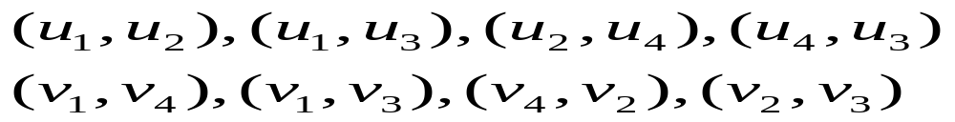
Isomorphism of Graphs
Example 8: G=(V, E) and H=(W, F)
u1
u2
v1
v2
u3
u4
v3
v4
G
H

Slide 27
Time Complexity
The are n! possible one-to-one correspondences between the vertex sets of two simple graphs with n vertices.
However, we can often show that two simple graphs are not isomorphic.
The properties of isomorphic graphs are two invariants:
(1) same number of vertices
(2) same degrees of v and f(v)

Slide 28
Isomorphism of Graphs
Example 9: G and H
b
b
a
c
a
c
e
G
d
e
H
d
G has no vertices of degree one, but H has one.

Slide 29
Isomorphism of Graphs
Example 10: G and H
a
b
s
t
e
f
w
x
h
g
z
y
v
u
d
G
c
G
They also both have four vertices of degree two and four of degree three. Are they isomorphism?

Slide 30
Isomorphism of Graphs
a
b
s
t
e
f
w
x
h
g
z
y
v
u
d
G
c
G
However, their adjacent vertices are different for their degrees are different.
Not isomorphism!!

Slide 31
Not isomorphism example
Another way to see that G and H are not isomorphic is to note that
the subgraphs of G and H made up of vertices of degree three and the edges connecting them must be isomorphic
if these two graphs are isomorphic.

Slide 32
To show that a function f from the vertex set of a graph G to the vertex set of a graph H is an isomorphism,we need to show that f preserves edges.
One helpful way to do this is to use adjacency matrices.
If f is isomorphism, we can show that the adjacency matrix of G is the same as the adjacency matrix of H with corresponding rows and columns.

Slide 33
Isomorphism of Graphs
u1
u2
v1
v3
v2
u6
u5
v6
u4
v5
v4
G
u3
H
G and H have six vertices and seven edges. Both have four vertices of degree two and two vertices of degree three.
The subgraphs of G and H consisting of all vertices of degree two and the edges connecting them are isomorphic.

Slide 34
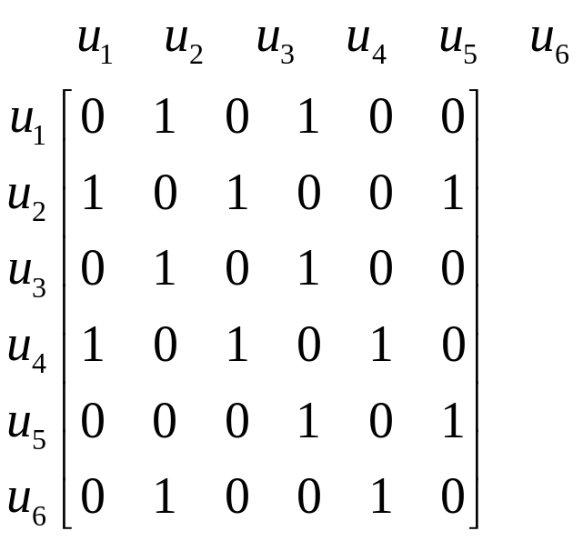
Adjacency Matrix of G
u1
u2
u6
u5
u4
G
u3

Slide 35
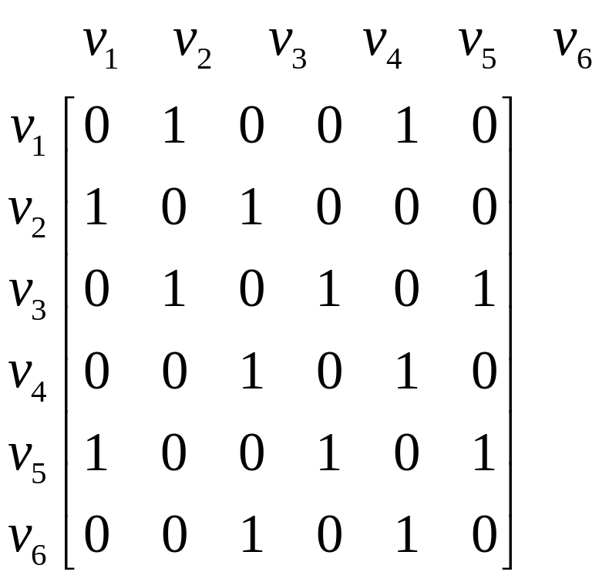
Adjacency Matrix of H
v1
v3
v2
v6
v5
v4
H

Slide 36
Isomorphism of Graphs
u1
u2
v1
v3
v2
u6
u5
v6
u4
v5
v4
G
u3
H
u1’s adjacency vertices (u2 and u4) have 3 degree.
v6 or v4.
Try f(u1)=v6, f(u2)=v3, f(u3)=v4, f(u4)=v5
f(u5)=v1, f(u6)=v2

Slide 37
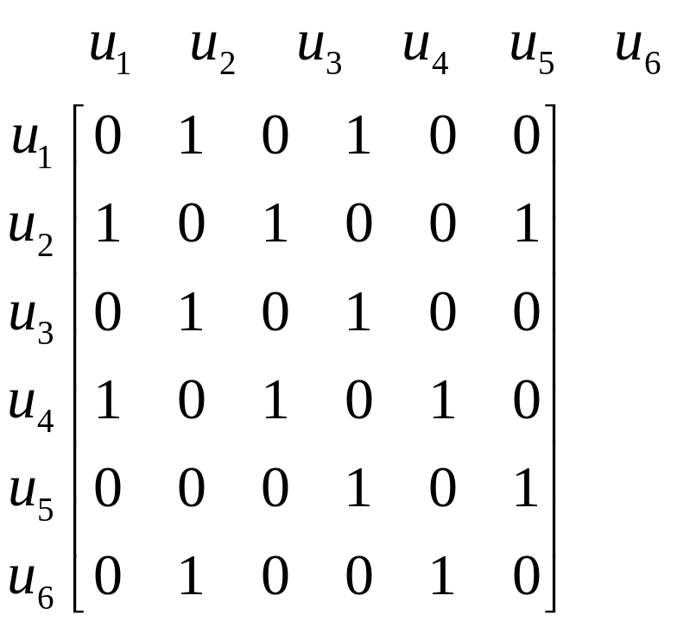
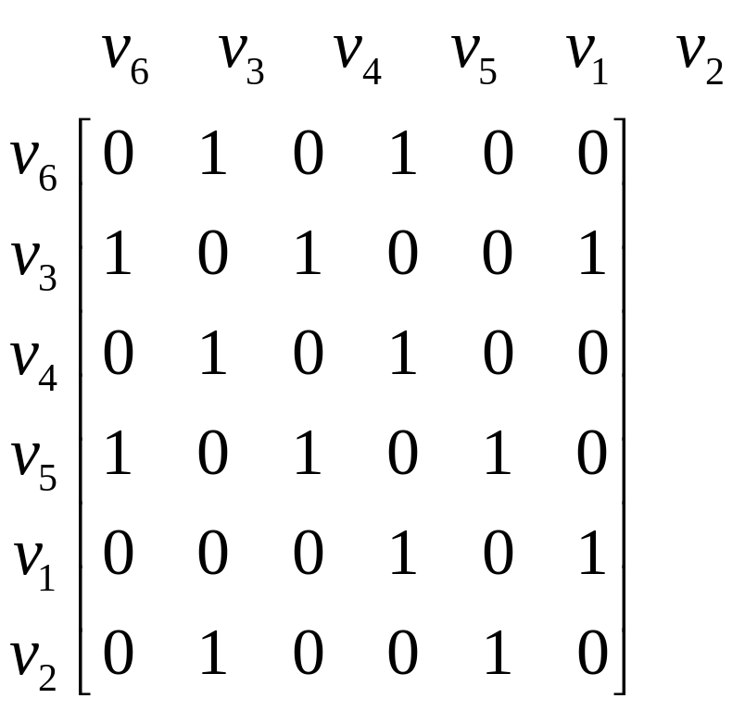
f(u1)=v6, f(u2)=v3, f(u3)=v4, f(u4)=v5, f(u5)=v1, f(u6)=v2

Slide 38
The best algorithms known for determining whether two graphs are isomorphic have exponential worst-case time complexity.
Linear average-case time complexity for some
Polynomial worst-case time complexity is hoped
The best algorithm is called NAUTY, which uses less than one second in determining two 100-vertex graphs are isomorphic.

Slide 39
necessary condition
Two isomorphic graphs have:
1、same number of vertices
2、same number of edges
3、same number of same-degree vertices
However, there has been no sufficient condition for determining whether two graphs are isomorphic.

Slide 40
Applications

Slide 41
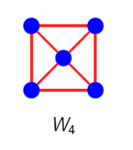
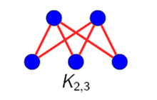
Applications
1.Represent each of these graphs with an adjacency matrix.
1
1
2
2
5
3
5
4
3
4

Slide 42
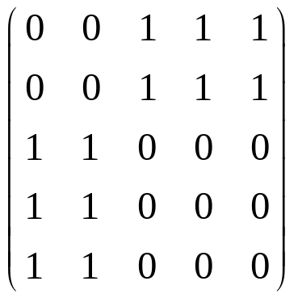
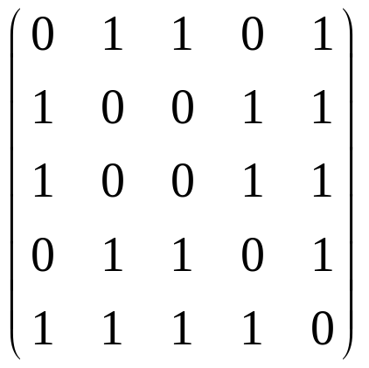
Applications
1.Represent each of these graphs with an adjacency matrix.
1
2
1
2
5
3
5
4
4
3

Slide 43
Applications
2. Determine whether the two graphs are isomorphism.
1
a
b
5
2
e
d
c
4
3

Slide 44
Applications
2. Determine whether the two graphs are isomorphism.
1
a
b
5
2
e
d
c
4
3
Define the function:
They are isomorphism.

Slide 45
End of Section 6.3
Click to edit company slogan .

